Slide 1


<Akrem Zaghdoudi>
<11/08/2024>

Slide 2

Outline
Executive Summary
Introduction
Methodology
Results
Conclusion
Appendix

Slide 3

Executive Summary
Summary of methodologies :
Data Collection through API and Web Scraping
Data Wrangling
Exploratory Data Analysis with SQL and Pandas
Exploratory Data Analysis with Data Visualization (Matplotlib)
Interactive Visual Analytics with Folium
Machine Learning Prediction (Classification)
Summary of all results :
Exploratory Data Analysis helped to choose the best features affecting the landing success.
Interactive analytics in screenshots that provided helpful insights.
Predictive Analytics showed the best model to predict .

Slide 4
Introduction
Project background and context
- SpaceX has revolutionized the space industry by significantly reducing launch costs, primarily due to the reusability of the Falcon 9 rocket's first stage. While a typical Falcon 9 launch costs $62 million, competitors' prices can soar to $165 million per launch. The ability to predict whether the Falcon 9's first stage will land successfully is crucial for estimating the overall cost of a launch. This prediction model can also provide valuable insights for other companies, like a hypothetical competitor Space Y, seeking to bid against SpaceX for rocket launches
Problems We want to find answers :
How can we accurately estimate the total cost of a launch ?
Where could be the best location to make those launchs ?
What are the factors that play a significant role in determining whether the Falcon 9 first stage will land successfully ?

Slide 5

Section 1

Slide 6
Methodology
Executive Summary
Data collection methodology:
Data was collected from two sources : Space X API and WebScrapping (Wikipedia)
Perform data wrangling
Collected data was enhanced by creating a landing outcome labelbased on the outcome data, after summarizing and analyzing the relevant features
Perform exploratory data analysis (EDA) using Data visualization and SQL
Perform interactive visual analytics using Folium and Plotly Dash
Perform predictive analysis using classification models
Collected data was normalized and split into training and test datasets, then evaluated with four different classification models, with each model's accuracy .

Slide 7
Data Collection
• The data sets were collected from: :
- The SpaceX API , the data collection was done using get request method .Next, we decoded the response content as a Json using .json() function call and turn it into a pandas dataframe using .json_normalize().
- A permanently linked Wikipedia page with launch data in HTML tables which we performed web scraping from with BeautifulSoup. We extracted the records then parse the table and convert it to a pandas dataframe for future analysis
• We then cleaned the data, checked for missing values and fill in missing values where necessary.

Slide 8
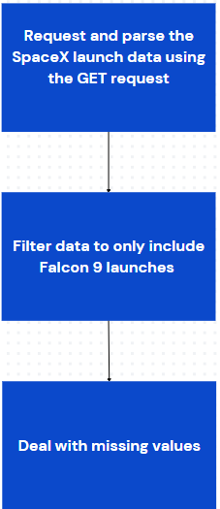
Data Collection – SpaceX API
SpaceX offers a public API from where data can be obtained and then used; (« https://api.spacexdata.com/v4/rockets/ »)
GitHub URL of the completed notebook: https://github.com/zaghdoudiakrem/Data_science_capstone/blob/main/1-Collecting_the_data_from_SpaceX_API.ipynb

Slide 9
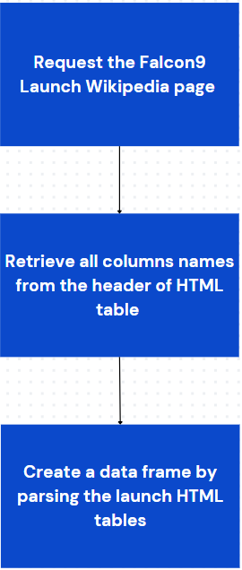
Data Collection - Scraping
Data was scraped from Wikipedia(«https://en.wikipedia.org/w/index.php?title=List_of_Falcon_9_and_Falcon_Heavy_launches&oldid=1027686922»)
GitHub URL of the completed notebook: https://github.com/zaghdoudiakrem/Data_science_capstone/blob/main/2-Web_scraping_from_Wiki.ipynb

Slide 10
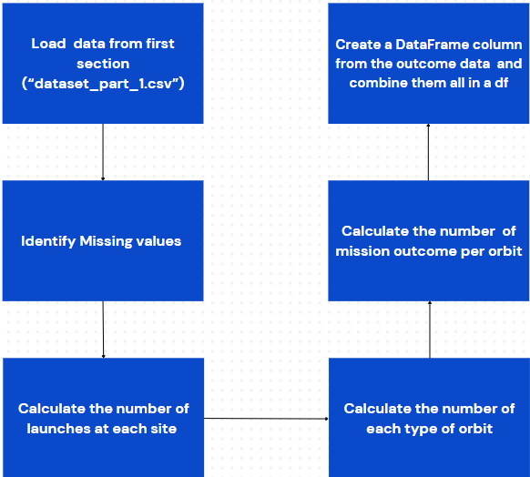
Data Wrangling
We performed EDA to identify patterns in the data , analyze the dataset and establish the appropriate training labels
GitHub URL of the completed notebook:
https://github.com/zaghdoudiakrem/Data_science_capstone/blob/main/3-Data_wrangling.ipynb

Slide 11
EDA with Data Visualization
Many charts were plotted we used them to analyze :
Launch Site Trends:
- Scatterplot illustrating the relationship between mission outcome, Launch Site, and Flight Number.
- Scatterplot showing the relationship between mission outcome, Launch Site, and Payload.
Orbit Type Trends
- Bar chart depicting the relationship between mission outcome and Orbit Type.
- Scatterplot displaying the relationship between mission outcome, Orbit Type, and Flight Number.
- Scatterplot revealing the relationship between mission outcome, Orbit Type, and Payload.
Temporal Trends
- Line plot demonstrating the trend of mission outcomes over the years.
GitHub URL of the completed notebook: https://github.com/zaghdoudiakrem/Data_science_capstone/blob/main/5-Data_Visualization.ipynb

Slide 12

EDA with SQL
We loaded the Space X dataset into the corresponding table in a Db2 database
We executed SQL queries to get answers :
Identify the unique names of launch sites in the space mission dataset.
Determine the top 5 launch sites with names beginning with 'CCA'.
Calculate the total payload mass carried by boosters launched by NASA (CRS).
Find the average payload mass for the booster version F9 v1.1.
Retrieve the date of the first successful landing outcome on a ground pad.
List the boosters that have successfully landed on a drone ship with a payload mass between 4000 and 6000 kg.
Count the total number of successful and failed mission outcomes.
Identify the booster versions that have carried the maximum payload mass.
Analyze failed landing outcomes on a drone ship in 2015, including booster versions and launch site names. Finally, rank the count of landing outcomes between the date 2010-06-04 and 2017-03-20,
GitHub URL of the completed notebook:
https://github.com/zaghdoudiakrem/Data_science_capstone/blob/main/4-EDA_with_sql.ipynb

Slide 13
Build an Interactive Map with Folium
Summary of Map Objects Added to the Folium Map and their purpose :
Markers: Identified each launch site and the NASA Johnson Space Center.
Purpose: Pinpointed specific locations of launch sites and major centers like NASA Johnson Space Center.
Circles: Highlighted areas around each launch site.
Purpose: Emphasized the vicinity of launch sites to provide spatial context.
Lines: Displayed distances from CCAFS LC-40 to nearby features such as the coastline, rail line, and perimeter road.
Purpose: Measured and visualized distances to assess logistics and accessibility.
Marker Clusters: Grouped launch events with color coding to represent success rates.
Purpose: Facilitated identification of sites with higher success rates and understanding of launch patterns.
GitHub URL of the completed notebook: https://github.com/zaghdoudiakrem/Data_science_capstone/blob/main/6-Launch_site_location.ipynb

Slide 14
Build a Dashboard with Plotly Dash
Summary of Plots/Graphs and Interactions Added to the Dashboard:
Pie Charts:
Description: Displayed the distribution of total launches by site and provided a visual breakdown of launches at different sites, allowing users to compare the volume of launches across sites.
Scatter Plots:
Description: Illustrated the relationship between mission outcomes and payload mass for different booster versions and enabled analysis of how payload mass correlates with launch outcomes across various booster versions.
Input Dropdown:
Description : Allowed users to select one or all launch sites for the pie chart and scatterplot.
Input Slider:
Description : Filtered payload masses for the scatterplot and enabled users to focus on specific ranges of payload masses, enhancing the analysis of payload impact on mission outcomes.
GitHub URL of the completed script: https://github.com/zaghdoudiakrem/Data_science_capstone/blob/main/spacex_dash_app.py

Slide 15
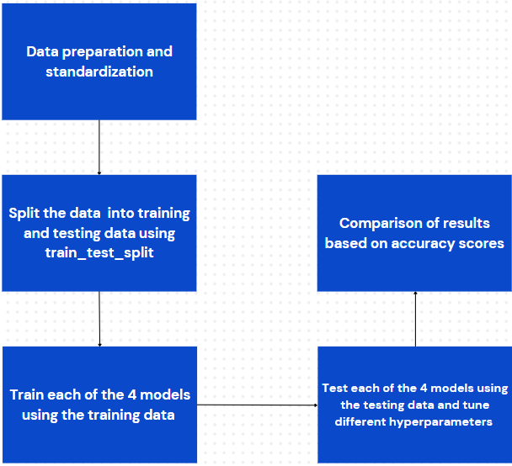
Predictive Analysis (Classification)
Hyper-parameters were evaluated using GridSearchCV() and the best was selected using ‘.best_params
Using the best hyper-parameters, each of the four models were scored on accuracy by using the testing data set.
GitHub URL of the completed notebook:
https://github.com/zaghdoudiakrem/Data_science_capstone/blob/main/7-SpaceX_Machine_Learning_Prediction_.ipynb

Slide 16
Results
Exploratory data analysis results
Interactive analytics demo in screenshots
Predictive analysis results

Slide 17

Section 2

Slide 18
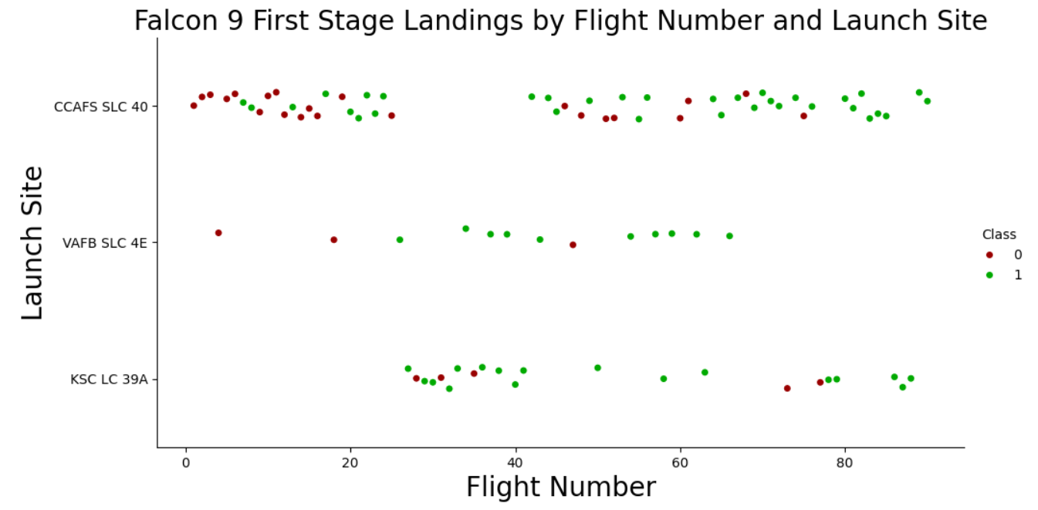
Flight Number vs. Launch Site
CCAFS SLC 40 is currently the most successful launch site, with VAFB SLC 4E and KSCLC 39A following. The overall success rate has improved over time. While a higher payload mass at CCAFS SLC 40 is generally associated with a better success rate, the visualization does not clearly establish a direct link between launch site success and payload mass.

Slide 19
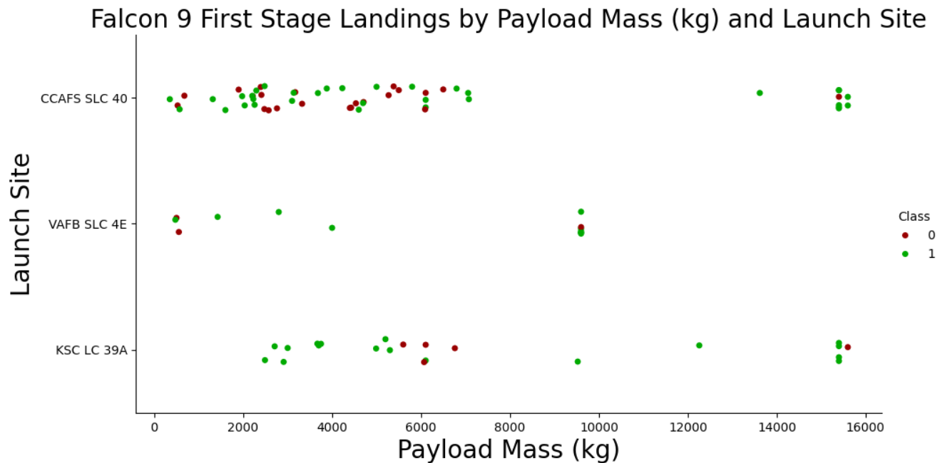
Payload vs. Launch Site
The greater the payload mass for launch site CCAFS SLC 40 the higher the success rate for the rocket.

Slide 20
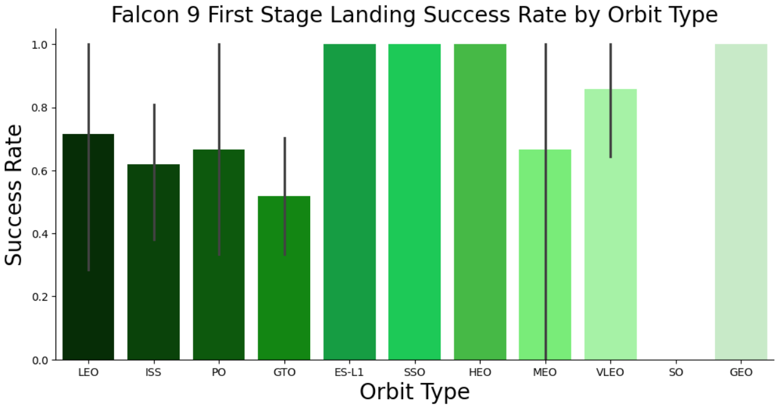
Success Rate vs. Orbit Type
The orbit types ES-L1, GEO, HEO, and SSO have the highest success rates, but it's important to consider the number of launches per orbit type when interpreting these results.

Slide 21
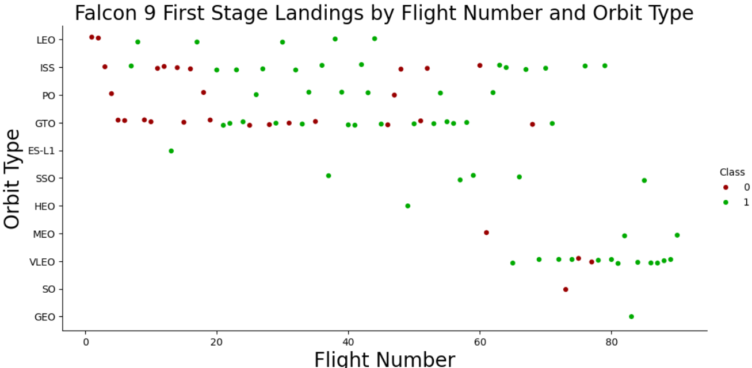
Flight Number vs. Orbit Type
In LEO orbits, success is linked to the number of flights, while in GTO orbits, there is no clear relationship between flight number and success.

Slide 22
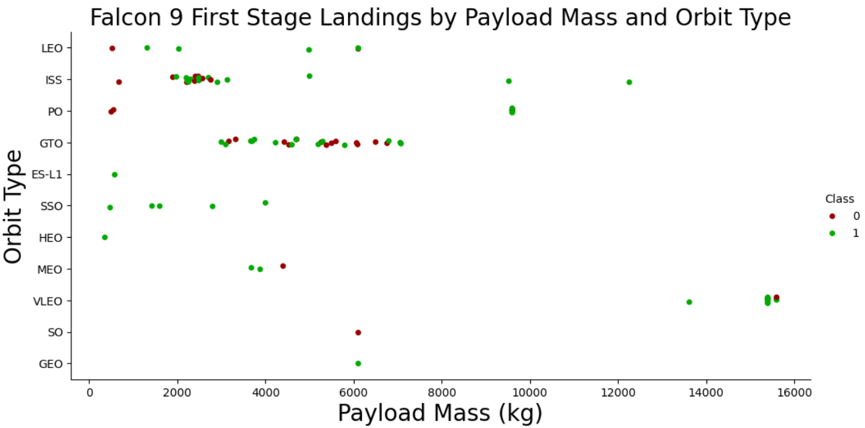
Payload vs. Orbit Type
• Some orbit types have better success rates than others . Success rate appears to have no obvious correlation with payload mass.

Slide 23
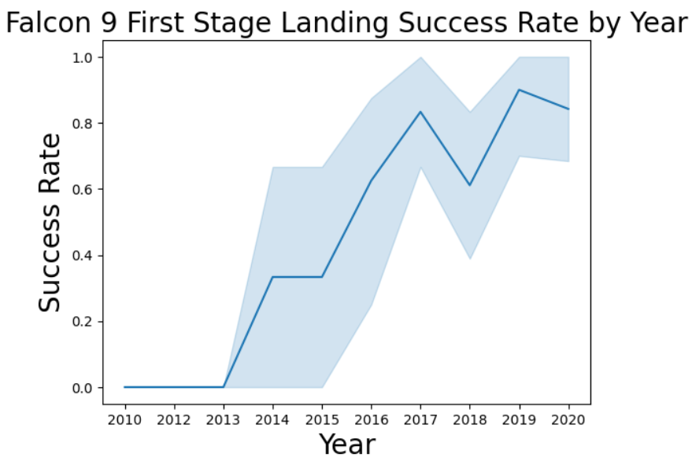
Launch Success Yearly Trend
Based on the plot , we can observe that success rate has increased since 2013 and kept on increasing till 2020

Slide 24
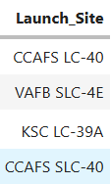
All Launch Site Names
Query: SELECT DISTINCT LAUNCH_SITE FROM SPACEXTABLE;
Result:
Explanation : As its showen in the result there are 4 unique launch sites

Slide 25
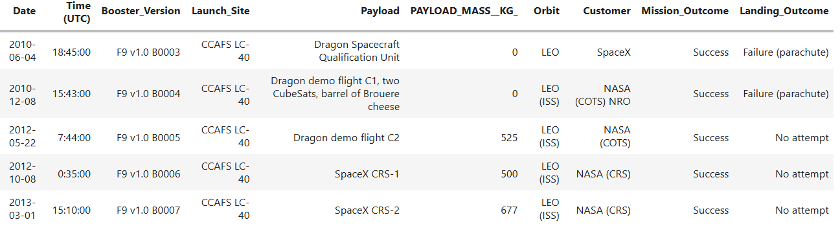
Launch Site Names Begin with 'CCA'
Query : SELECT * FROM SPACEXTABLE WHERE launch_site LIKE 'CCA%' LIMIT 5;
Result :
Explanation : This is a simple method used to get an idea of the data stored in the database table.

Slide 26
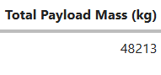
Total Payload Mass
Query : SELECT sum(payload_mass__kg_) AS "Total Payload Mass (kg)" FROM SPACEXTABLE WHERE customer LIKE '%NASA (CRS)%';
Result :
Explanation : The total payload transported by NASA boosters is 48,213 kg.

Slide 27
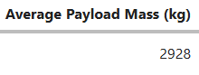
Average Payload Mass by F9 v1.1
Query : SELECT sum(payload_mass__kg_) / count(payload_mass__kg_) AS “Average Payload Mass (kg)" FROM SPACEXTABLE WHERE booster_version LIKE 'F9 v1.1';
Result :
Explanation : The average payload mass transported by the F9 v1.1 booster version is 2,928 kg.

Slide 28
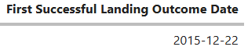
First Successful Ground Landing Date
Query : SELECT min(DATE) AS "First Successful Landing Outcome Date" FROM SPACEXTABLE WHERE landing__outcome LIKE ‘Success (ground pad)’;
Result :
Explanation : The first successful ground pad landing occurred on December 22, 2015

Slide 29
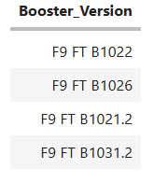
Successful Drone Ship Landing with Payload between 4000 and 6000
Query : SELECT DISTINCT booster_version FROM SPACEXTABLE WHERE landing__outcome = 'Success (drone ship)' and payload_mass__kg_ BETWEEN 4000 and 6000;
Result :
Explanation : The four booster versions that have successfully landed on drone ship with a payload mass between 4,000 kg and 6,000 kg are listed above.

Slide 30
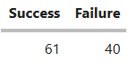
Total Number of Successful and Failure Mission Outcomes
Query : SELECT (SELECT count(*) FROM SPACEXTABLE WHERE LOWER (landing_outcome) LIKE '%success%') AS "Success“, count(*) AS "Failure" FROM SPACEXTABLE WHERE LOWER (landing_outcome) NOT LIKE '%success%’;
Result :
Explanation : There were 61 successful and 40 failed mission outcomes.

Slide 31
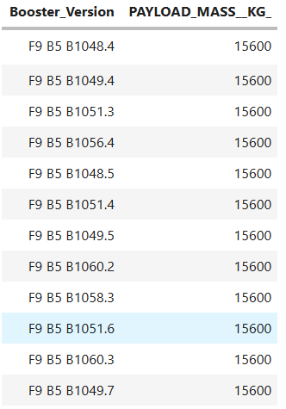
Boosters Carried Maximum Payload
Query : SELECT booster_version, payload_mass__kg_ FROM SPACEXTABLE WHERE payload_mass__kg_ = (SELECT max(payload_mass__kg_) FROM SPACEXTABLE);
Result :
Explanation : The dataset shows a maximum payload mass of 15,600 kg, which was carried by twelve separate Falcon 9 boosters.

Slide 32
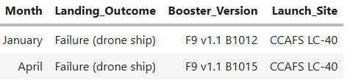
2015 Launch Records
Query : SELECT MONTHNAME(DATE) AS “Month”, landing__outcome, booster_version, launch_site FROM SPACEXTABLE WHERE landing__outcome = 'Failure (drone ship)' AND YEAR(DATE) = 2015;
Result :
Explanation : The total payload carried by boosters from NASA is 48,213 kg.

Slide 33
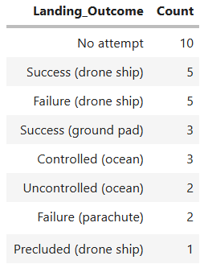
Rank Landing Outcomes Between 2010-06-04 and 2017-03-20
Query : SELECT landing__outcome, count(landing__outcome) AS "Count" FROM SPACEXTABLE WHERE DATE BETWEEN '2010-06-04' AND '2017-03-20' GROUP BY landing__outcome ORDER BY count(landing__outcome) DESC;
Result :
Explanation : The most common landing outcome was ‘not attempted’ (10 ).

Slide 34

Section 3

Slide 35
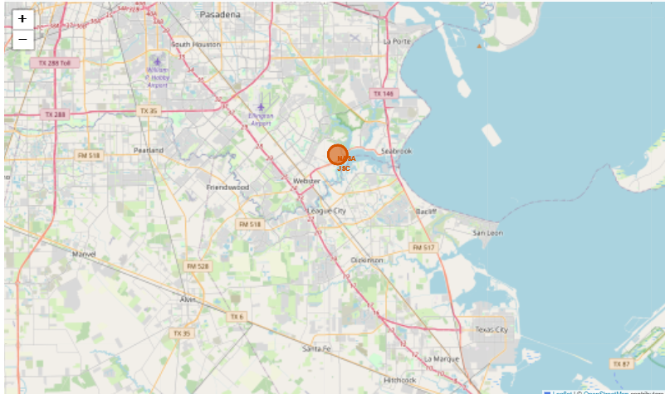
<Falcon 9 Launch Site Locations>

Slide 36
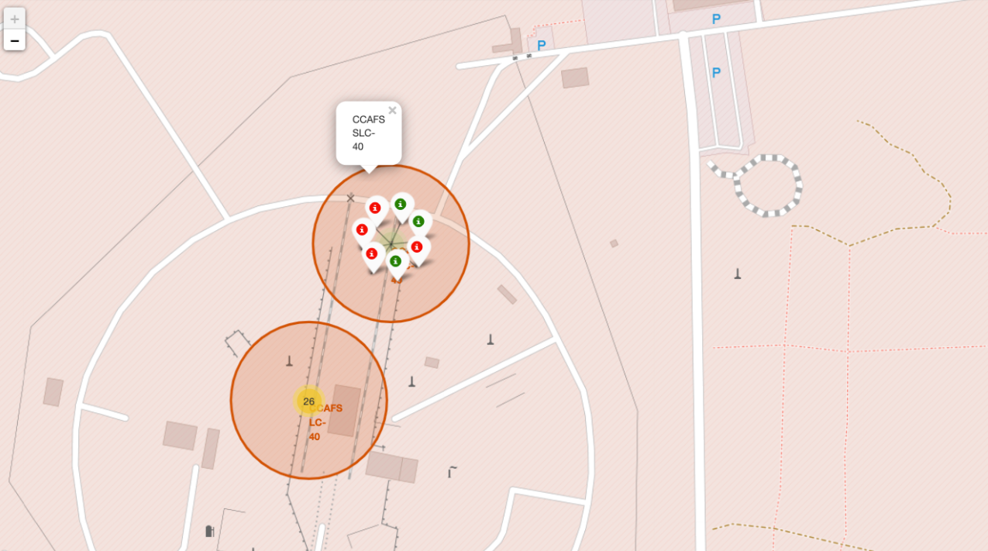
<Map Markers of Success/Failed Landings >
The markers represent the mission outcomes (Success/Failure) for Falcon 9 first stage landings, organized on the map to correspond with the geographical coordinates of the launch sites.

Slide 37
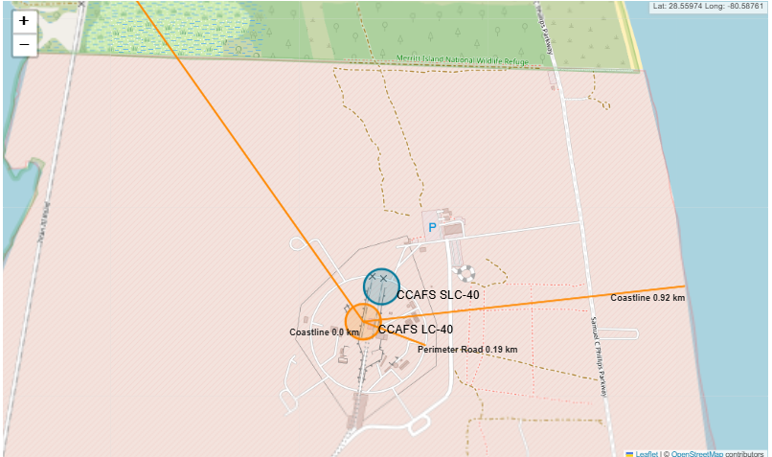
<Distance from Launch Site to Proximities >
• The perimeter road around CCAFS LC-40 is 0.19 km away from the launch site coordinates.
• The coastline is 0.92 km away from CCAFS LC-40.
• The rail line is 1.33 km away from CCAFS LC-40.

Slide 38

Section 4

Slide 39
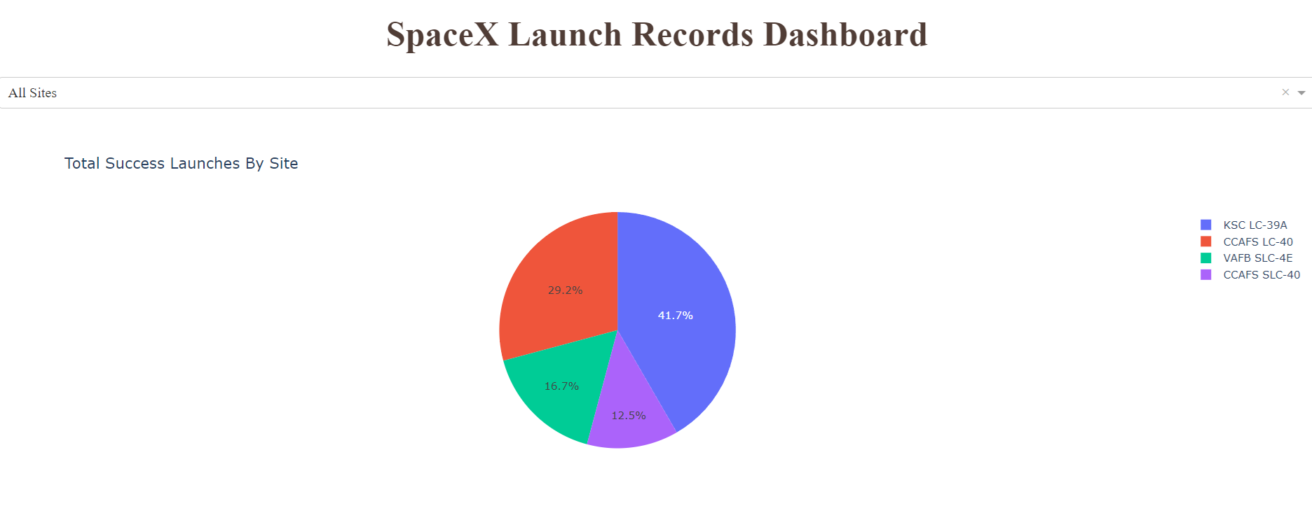
Total success launches by all sites
KSC LC-39A recorded the most successful launches among all sites.

Slide 40
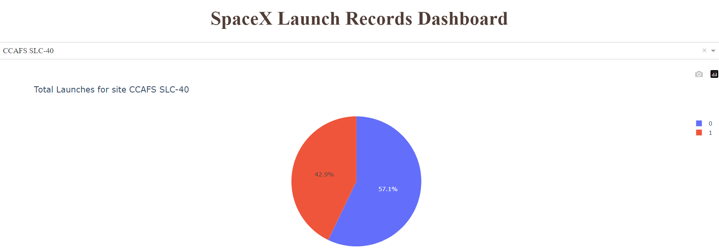
Success rate by site
KSC LC-39A had a 42.9% success rate (indicated by the ‘0’ Class ) and a 57.1% failure rate (indicated by the ‘1’ Class).

Slide 41
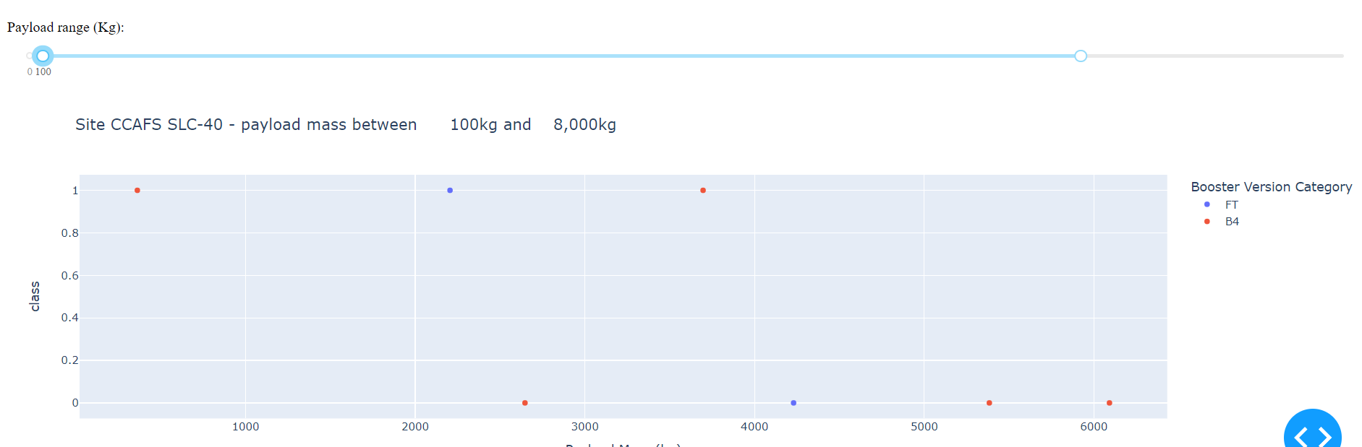
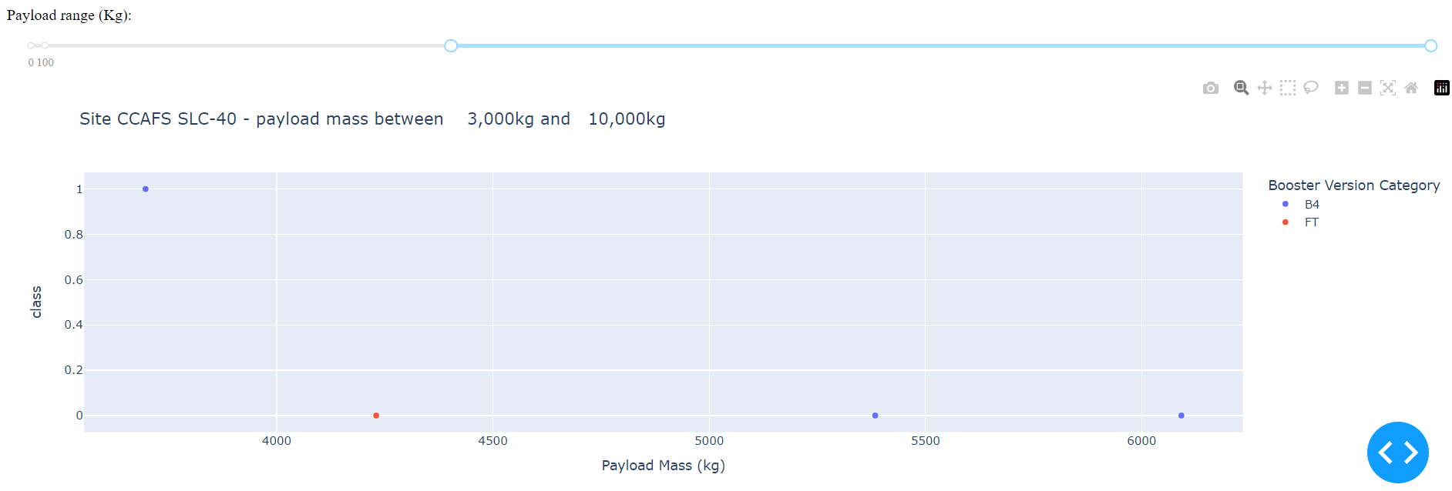
Payload vs. Launch Outcome
Success rates are higher for low-weight payloads compared to heavy ones.

Slide 42

Section 5

Slide 43
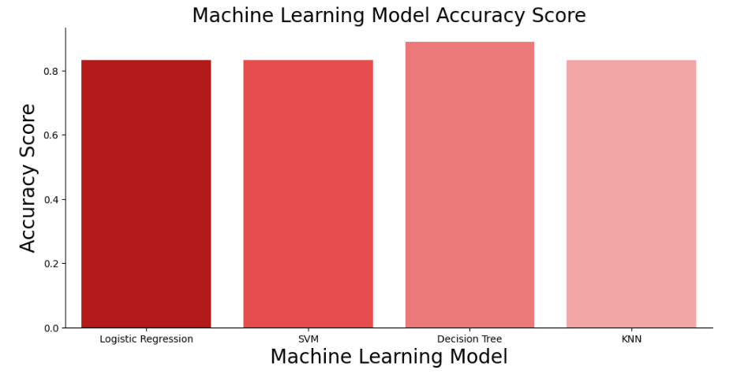
Classification Accuracy
All models performed comparably, except for the Decision Tree model, which lagged behind the others in performance.

Slide 44
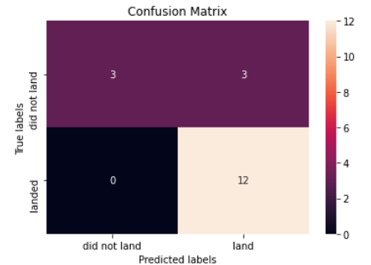
Confusion Matrix
The confusion matrix for the Decision Tree Classifier demonstrates its accuracy, with a high number of true positives and true negatives indicating effective classification. However, the classifier's primary challenge is the occurrence of false positives, where unsuccessful landings are incorrectly identified as successful
Prediction Breakdown:
• 12 True Positives and 3 True Negatives
• 3 False Positives and 0 False Negatives

Slide 45
Conclusions
Success Trends: SpaceX’s Falcon 9 first stage landing outcomes have improved over time, with success rates increasing notably from 2013 to 2020. KSC LC-39A emerged as the most successful launch site, and orbits such as ES-L1, GEO, HEO, SSO, and VLEO showed high success rates.
Payload Insights: Launches with payloads over 7,000 kg tend to be less risky, indicating that heavier payloads are associated with better outcomes.
Predictive Modeling: The Decision Tree Classifier is effective for predicting successful landings, offering a valuable tool for optimizing future missions and enhancing profitability.

Slide 46
Appendix
For notebook and datasets , check this Github repository link :
https://github.com/zaghdoudiakrem/Data_science_capstone/tree/main

Slide 47


